Slide 1

19MAT105 MATHEMATICAL FOR
INTELLIGENT SYSTEMS –1
FIRST SEMESTER PROJECT
TOPIC: DYNAMIC MODE DECOMPOSITION
BATCH 18:
AIEA.35072 RAHUL G
AIEA.33429 RISHI KARTHIGAYAN S
DATE:26-02-2021

Slide 2
INTRODUCTION:
Most of the systems in our daily life like an epidemiological system, financial markets, the climate, are examples of dimensional, nonlinear dynamical systems.
The DMD method originated in the fluid dynamics community as a method to decompose complex flows into a simple representation based on spatiotemporal coherent structures.
DMD can be applied in data science, encompassing a broad range of techniques, from machine learning and statistical regression to computer vision and compressed sensing. Improved algorithms, abundant data help in rapid development of DMD.

Slide 3






SVD:
SVD is defined to be a unique matrix decomposition that exists for every complex valued matrix,
where,
Here, the symbol ‘*’ represents the complex conjugate transpose, whereas, for real-valued matrices it is similar to the regular transpose.
Both U and V are unitary matrices which contain orthonormal columns and Σ contains real and non-negative entries on the diagonal and zeros off the diagonal. . A vector is considered to be unitary if,

Slide 4


When n ≥ m, the matrix Σ has at most m nonzero elements on the diagonal.
Matrix X is represented using the economic SVD as
The columns of Uˆ ⊥ span a vector space that is complementary and orthogonal to that spanned by Uˆ. The columns of U are called left singular vectors of X and the columns of V are right singular vectors. The diagonal elements of Σˆ is called singular values and are ordered from largest to smallest. Rank is the number of non-zero eigen values.

Slide 5

DMD:
The DMD method relies simply on collecting snapshots of data from a dynamical system at a number of times. DMD is algorithmically a regression of data onto locally linear dynamics
The algorithm involves a singular value decomposition (SVD) of the snapshot matrix constructed from the data.
The DMD method provides a spatiotemporal decomposition of data into a set of dynamic modes that are derived from snapshots of a given system in time. It involves two parameters n and m, which represent number of spatial points saved per time snapshot and number of snapshots taken.

Slide 6
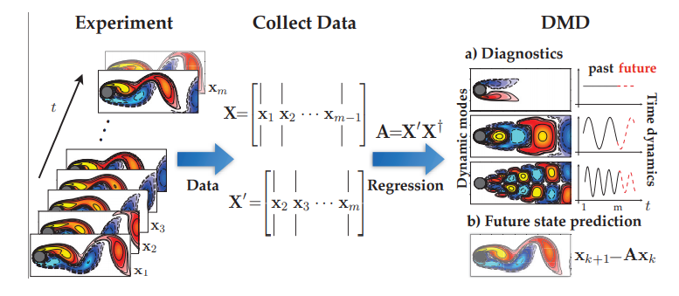
This is a schematic overview of DMD on a fluid flow example
The eigen decomposition of A˜ is used to approximate the eigen decomposition of the high dimensional matrix A.
DMD computes the leading eigen-decomposition of the best-fit linear operator A relating the data X' ≈ AX: A = X' X†. The DMD modes, also called dynamic modes, are the eigenvectors of A, and each DMD mode corresponds to a particular eigenvalue of A.

Slide 7






DMD ALGORITHM:
For a matrix A with large state dimension, DMD avoids the eigen decomposition of A by considering a rank-reduced representation in terms of a POD projected matrix Ã. The DMD algorithm proceeds as follows:
The exact formulation may be used if,
φ = X VΣ−1w = 0. Otherwise, the projected DMD formulation φ = UW, should be used.
The matrix Ã defines a low dimensional linear model of the dynamical system on the POD coordinates.

Slide 8
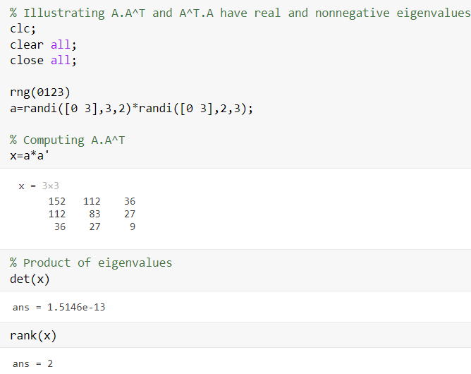
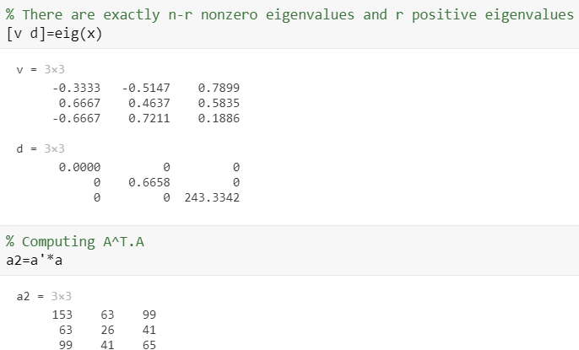
CODES:
1.)

Slide 9
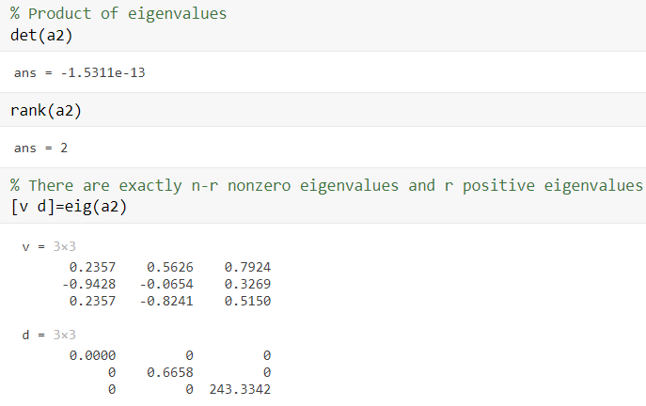

Slide 10
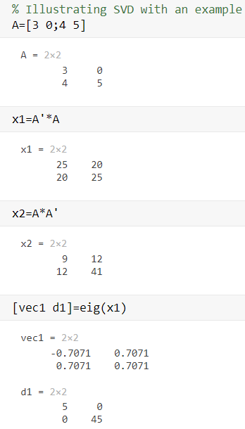
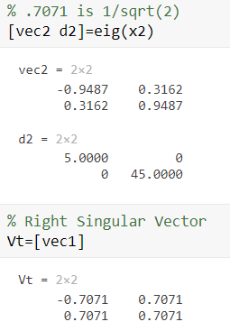
2.)

Slide 11
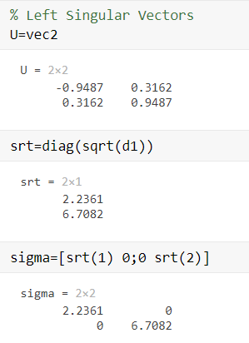
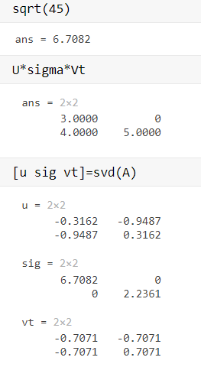

Slide 12
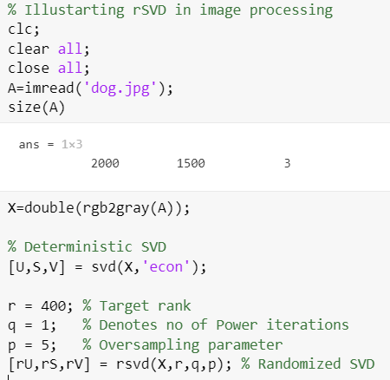
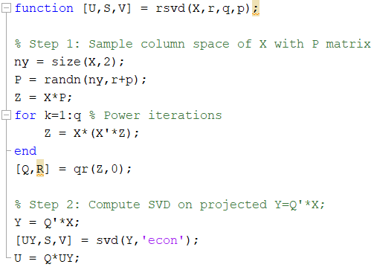
3.) RANDOMIZED SVD:

Slide 13
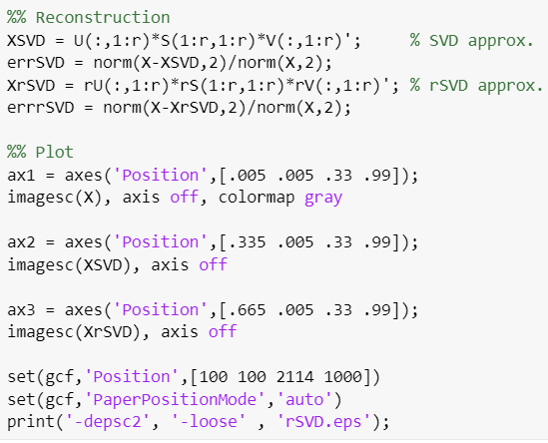
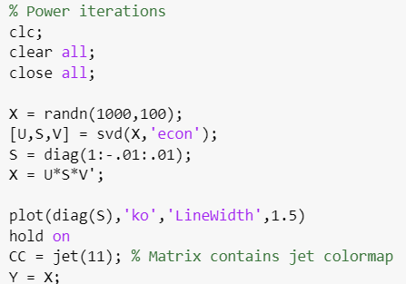
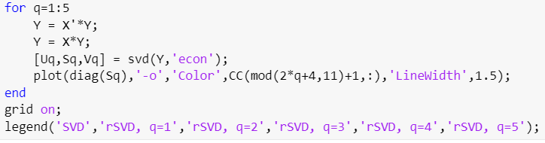

Slide 14
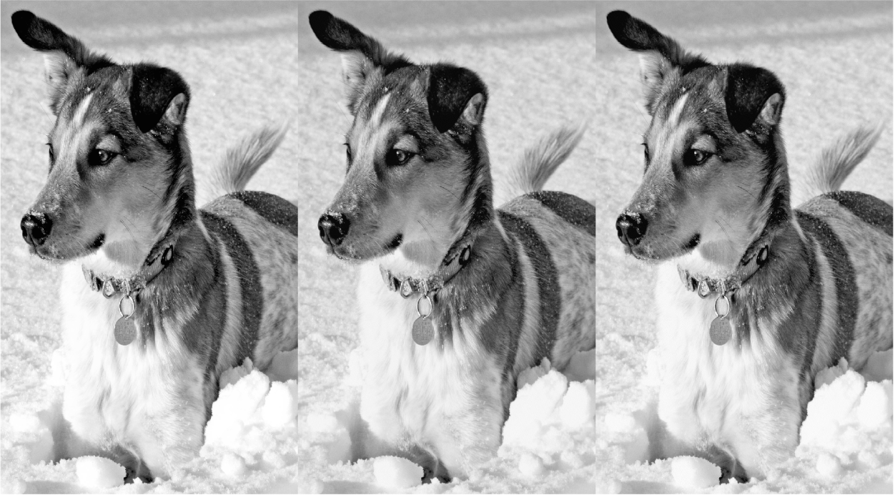
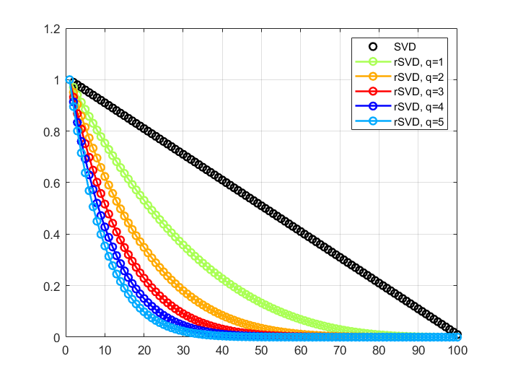
3.) RESULT:

Slide 15
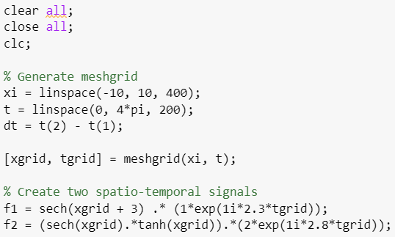
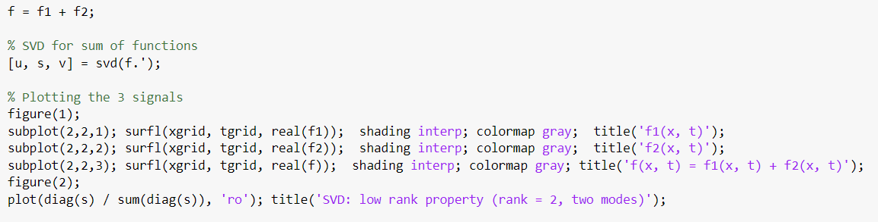
4.) DMD:

Slide 16
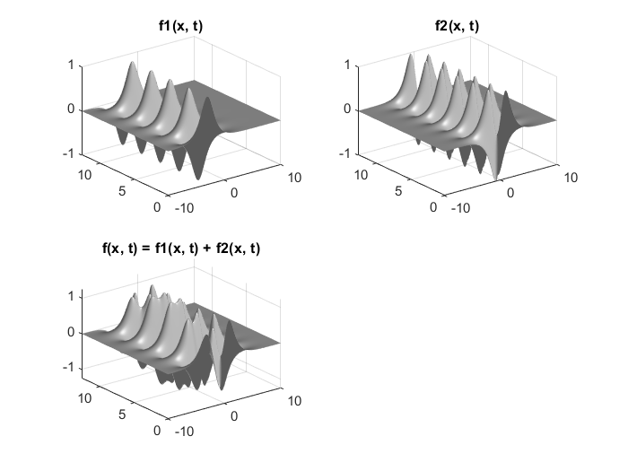
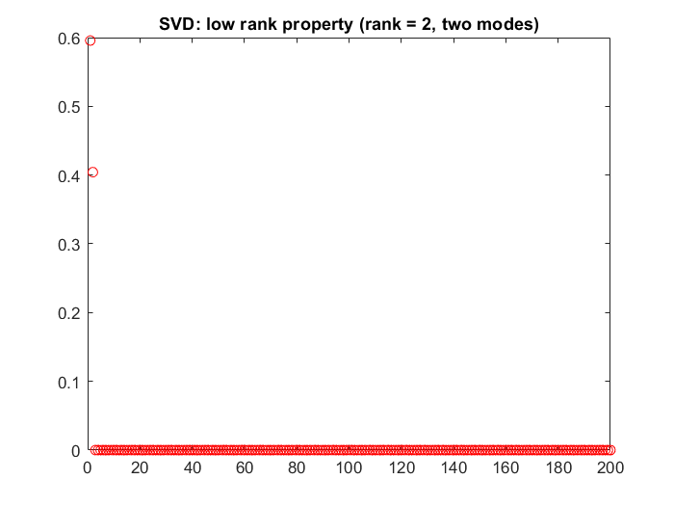
RESULT:

Slide 17
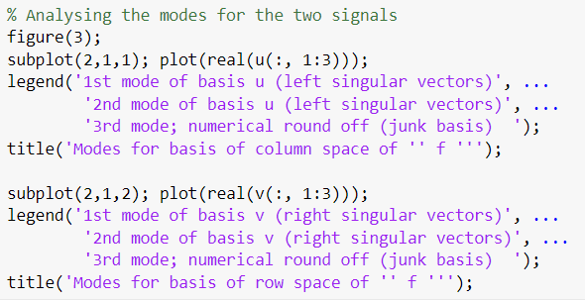
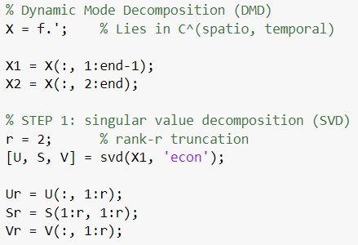

Slide 18
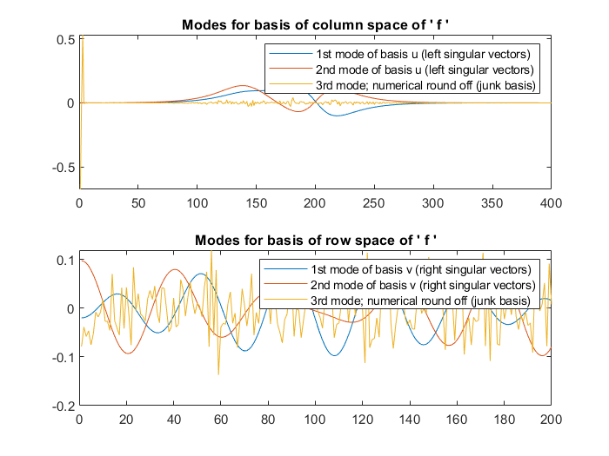

Slide 19
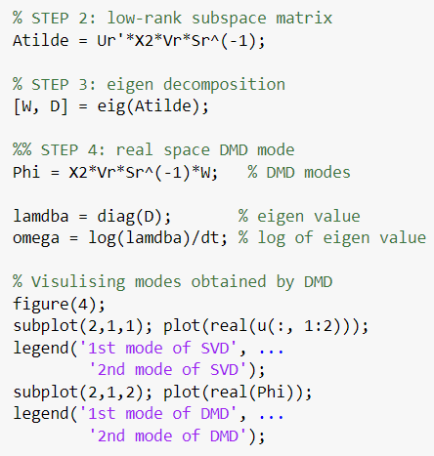

Slide 20
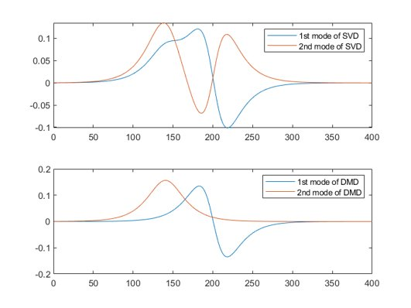

Slide 21
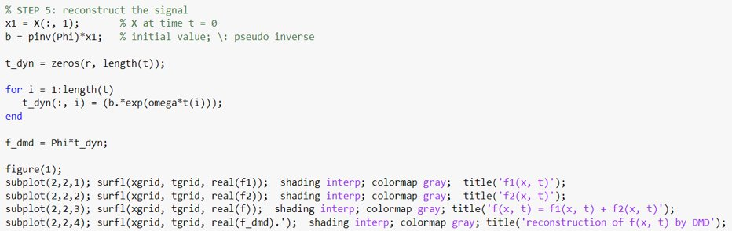

Slide 22
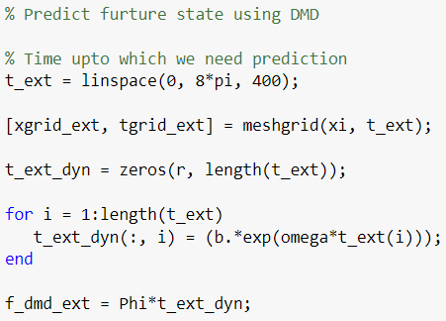
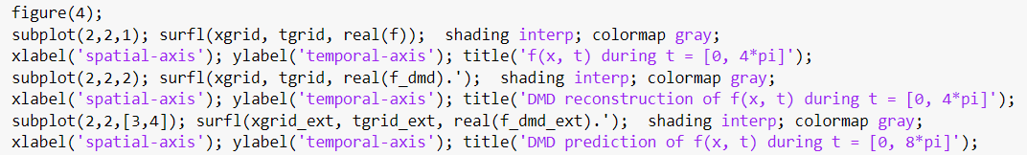

Slide 23
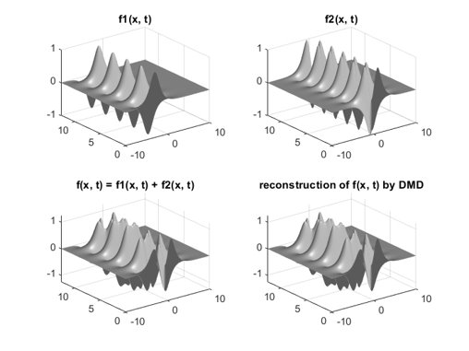

Slide 24
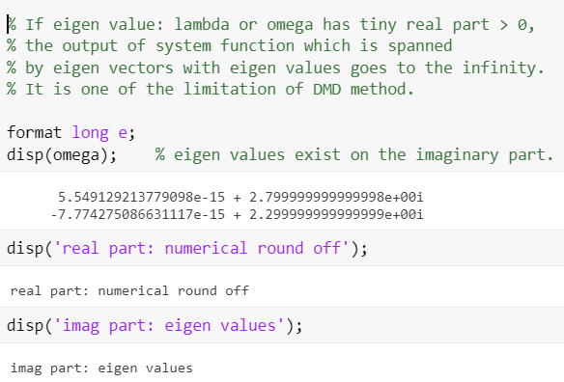

Slide 25
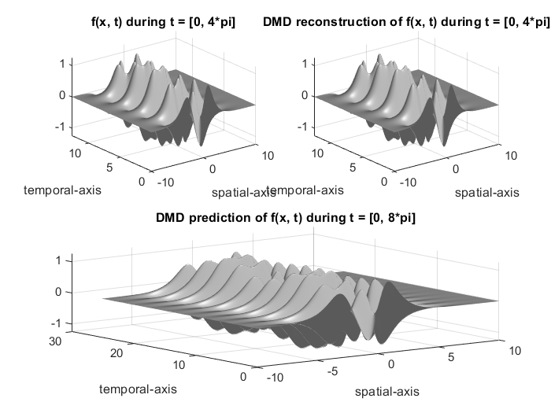

Slide 26
INFERENCE:
Thus, DMD is an equation-free, data-driven model, capable of providing short-span future state predictions by accurate decomposition of a complex system into spatiotemporal coherent structures.

Slide 27

THANK YOU

